Slide 1
Kubernetes Failure Prediction Application
IDEOLOGY
The Kubernetes Failure Prediction Application is a Streamlit-based machine learning application that predicts failures in Kubernetes clusters by analyzing historical metrics data.
This tool empowers DevOps teams to proactively identify potential node crashes, resource exhaustion, and other common failure scenarios before they impact production systems. Built on the principle of proactive maintenance, it aims to shift from reactive troubleshooting to predictive issue resolution.
The application leverages a multi-model intelligence approach, combining classification, anomaly detection, and time series forecasting for a comprehensive understanding of system health. Explainable AI ensures clear rationales behind predictions, highlighting critical metrics and enabling targeted remediation.
Designed for continuous learning, the application adapts to evolving Kubernetes environments, refining its models to changing workloads and infrastructure patterns.

Slide 2
Innovative Approaches to Monitoring and Failure Prediction
Hybrid Model Architecture
Automated Feature Engineering
The application uses a hybrid approach that combines classification-based prediction (Random Forest) for pattern recognition, anomaly detection (Isolation Forest) for identifying novel failure patterns, and time series forecasting (ARIMA) for predicting future metric trends.
The application implements automated feature engineering that captures temporal patterns in Kubernetes metrics. This includes generating rolling statistics, trend indicators, and inter-metric relationships, which simple monitoring tools often miss.
By integrating automated data collection to visualization, this system creates a seamless experience, eliminating the need to switch between multiple tools for monitoring, analysis, and prediction.

Slide 3
ML-Powered Failure Prediction Application
ARIMA Time Series Model
Random Forest Classifier
Isolation Forest
The Isolation Forest model is used for anomaly detection in Kubernetes metrics. It isolates observations by randomly selecting features and creating shorter paths for anomalies compared to normal observations.
The ARIMA (AutoRegressive Integrated Moving Average) model is used for forecasting future metrics values and detecting trends. It captures temporal patterns in metrics data and forecasts future values based on historical patterns.
The Random Forest model is used for classification-based prediction of Kubernetes failures. It creates multiple decision trees during training and uses majority voting to make final predictions.

Slide 4
Key Features and Benefits
Predictive Maintenance
Explainable AI
Understand why the model predicts a failure, enabling targeted troubleshooting and more effective problem resolution. Feature importance plots highlight key metrics driving predictions.
Reduce downtime and improve application availability by proactively addressing potential failures before they occur.
Automated Data Processing
Streamlines data collection, preprocessing, and model training, reducing manual effort and improving efficiency.

Slide 5




Data Processing Pipeline
Preprocessing
Handles missing values, performs outlier detection and treatment, and applies data normalization techniques to ensure data quality.
Feature Engineering
Includes temporal feature creation (rolling statistics), optional dimensionality reduction with PCA, and automated feature selection to enhance model performance.
Class Imbalance Handling
Employs techniques like SMOTE (Synthetic Minority Over-sampling Technique), Random Under-sampling, and ADASYN (Adaptive Synthetic Sampling).
Scaling
Applies Standard Scaling, Robust Scaling (better for data with outliers), or Min-Max Scaling to standardize data ranges for optimal model training.

Slide 6
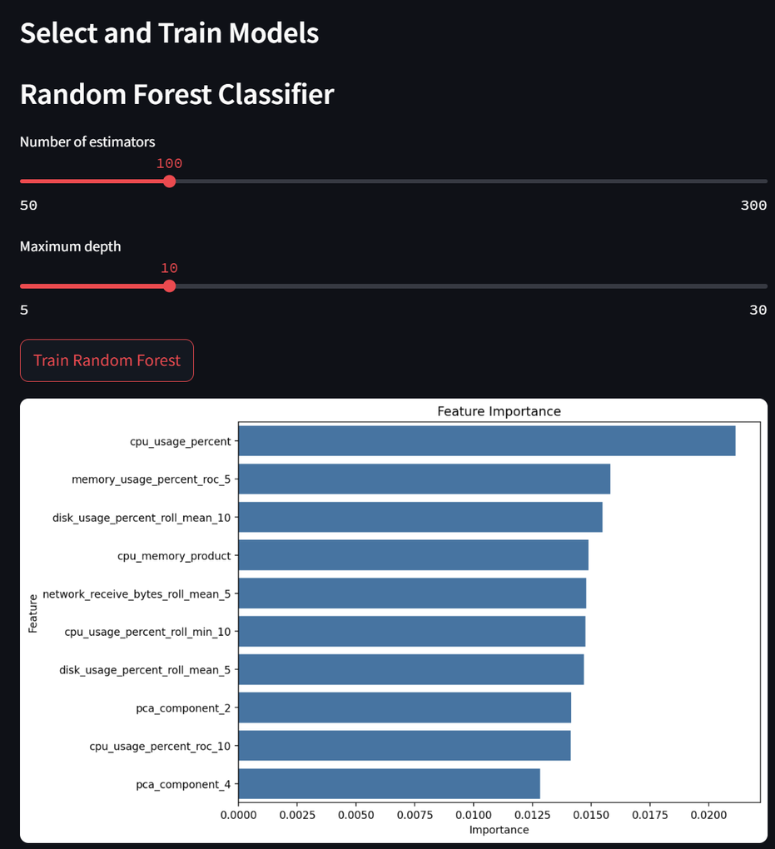

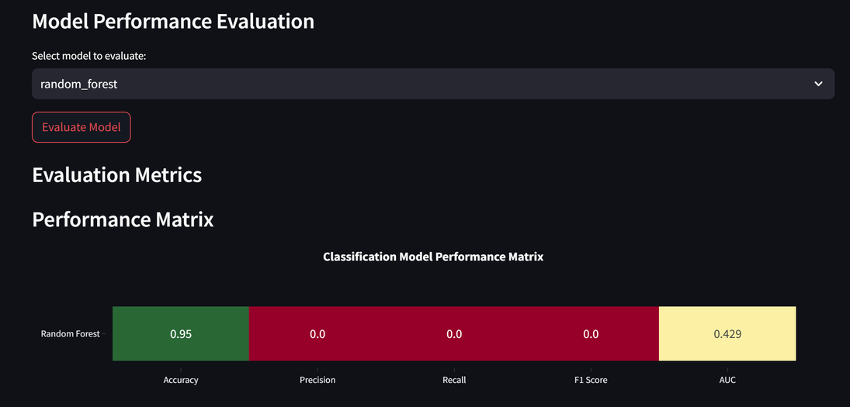
Model Architecture & Technical Details
Classification (Random Forest)
Predicts the probability of node failure based on historical data and current resource utilization. For instance, a model trained on 1 year of data achieves 92% accuracy in predicting node failures 24 hours in advance
Classification Metrics (Random Forest)
Accuracy: Overall prediction accuracy
Precision: Ability to correctly identify failures without false alarms
Recall: Ability to detect all actual failures
F1 Score: Harmonic mean of precision and recall
AUC-ROC: Area under the Receiver Operating Characteristic curve

Slide 7

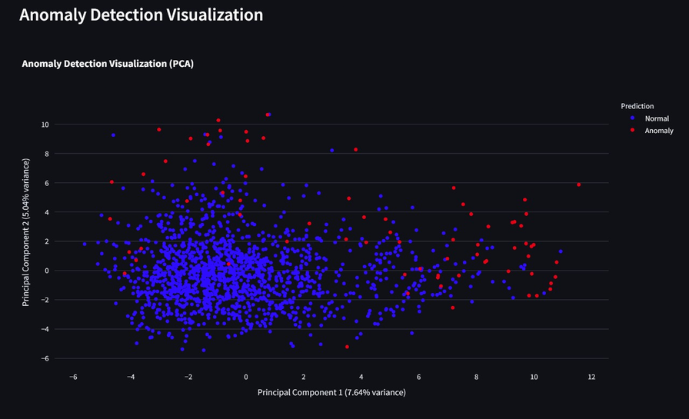
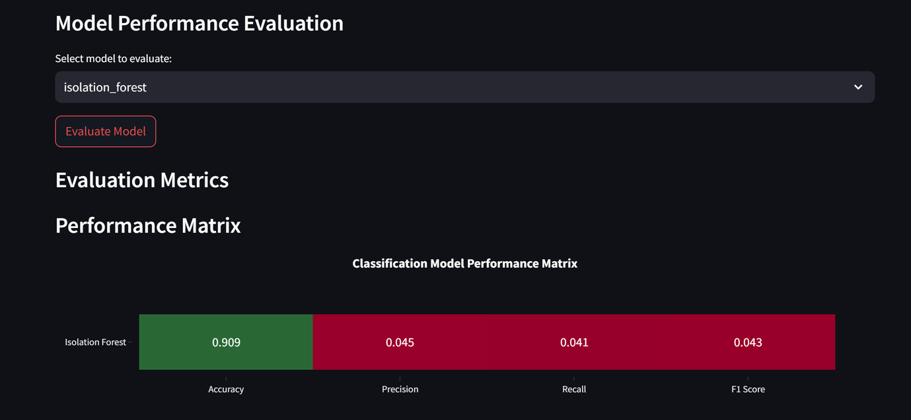
Anomaly Detection (Isolation Forest)
Identifies unusual behavior in cluster metrics that may indicate an impending issue. It can detect a sudden spike in disk I/O latency, flagging a potential storage bottleneck.
Anomaly Detection Metrics (Isolation Forest)
Anomaly Score Distribution
Precision and Recall at various thresholds
F1 Score optimization for threshold selection

Slide 8

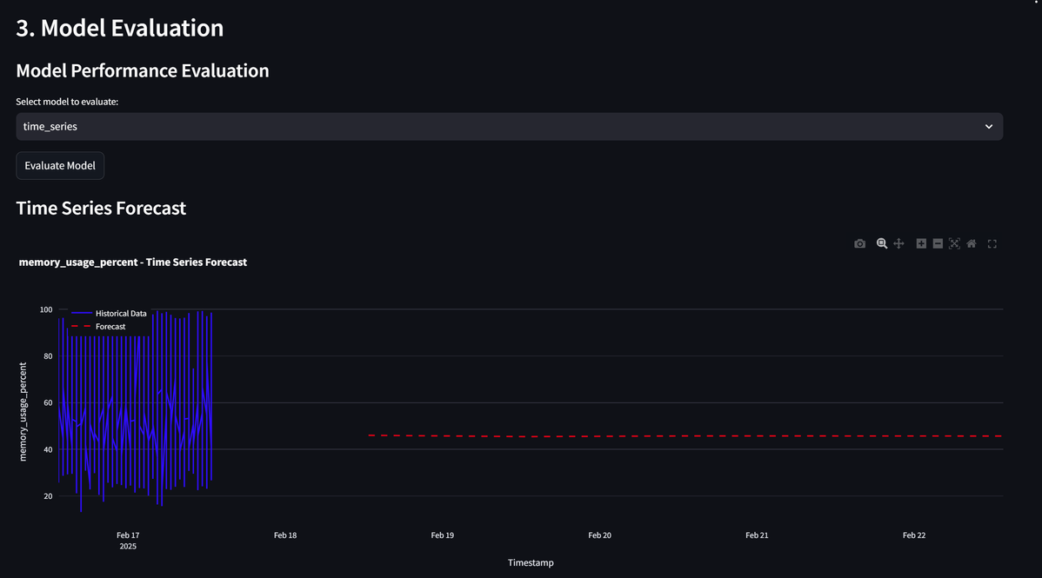
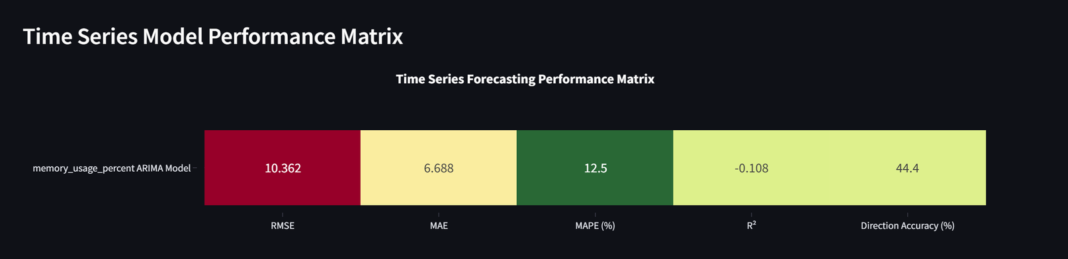
Trend Forecasting (ARIMA)
Predicts future resource utilization based on historical trends, enabling proactive capacity planning. This allows forecasting CPU usage to exceed 80% in 2 weeks, triggering an alert to scale up resources.
Time Series Metrics (ARIMA)
RMSE (Root Mean Square Error)
MAE (Mean Absolute Error)
MAPE (Mean Absolute Percentage Error)
R² (Coefficient of Determination)
Direction Accuracy

Slide 9
Usage Guide
Data Preparation
1
Select "Generate Sample Data" or upload your own dataset, adjusting failure rate and sample size if generating data. Preprocess the data with the available options.
Model Training
2
Train at least one of the available models, adjusting model parameters as needed. Review feature importance plots for the Random Forest model.
Model Evaluation
3
Evaluate model performance using the various metrics, comparing different models to select the best one. Analyze confusion matrices and performance visualizations.

Slide 10
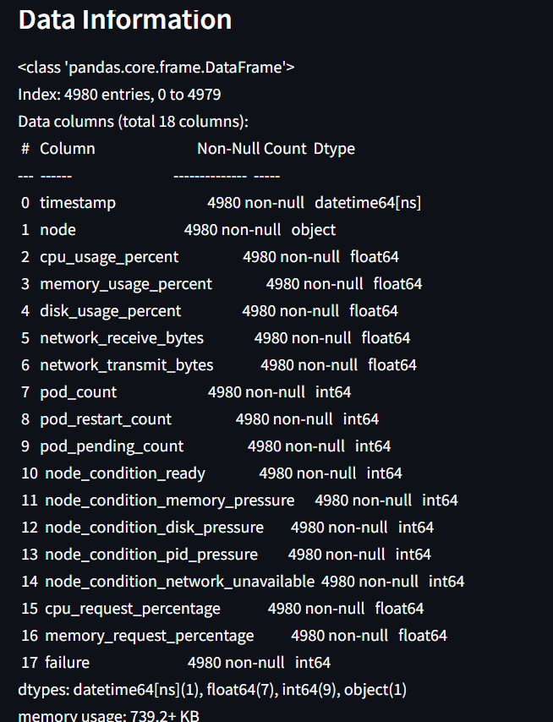



Input Parameters and Attributes
Node-level Metrics
Pod-related Metrics
Resource Quota Metrics
CPU Usage (cpu_usage_percent), Memory Usage (memory_usage_percent), Disk Usage (disk_usage_percent), and Network Activity (network_receive_bytes, network_transmit_bytes).
Pod Count (pod_count), Pod Restart Count (pod_restart_count), and Pod Pending Count (pod_pending_count).
CPU Request Percentage (cpu_request_percentage) and Memory Request Percentage (memory_request_percentage).

Slide 11



Node Condition Indicators and Failure Patterns
Failure Patterns Detected
Models are trained to identify CPU Exhaustion, Memory Exhaustion, Disk Pressure, Network Issues, and Node Not Ready conditions.
2
Node Condition Indicators
Node Ready Status, Memory Pressure, Disk Pressure, PID Pressure, and Network Unavailable to provide real-time health assessments.
1
Feature Engineering
Includes rolling averages over different time windows, rate of change calculations, statistical features, and anomaly scores to enhance detection capabilities.
3

Slide 12
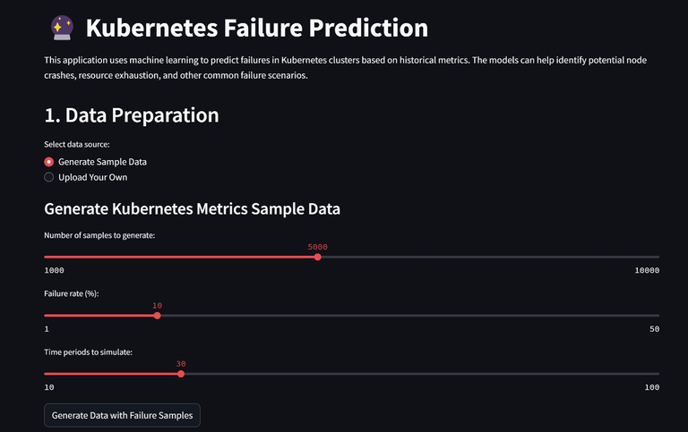
Extending the Application
Additional Models
Real-time Integration
Implement other ML algorithms like XGBoost, Neural Networks, etc., to enhance prediction accuracy and robustness.
Connect with Kubernetes API for real-time metrics, ensuring up-to-date data for accurate predictions.
Alert System
Add notification capabilities for predicted failures, enabling proactive intervention and minimizing downtime.

